Slide 1
Network and Computer Security
Chapter 3 – Network and communication security
Prof. dr. ir. Eli De Poorter
© Eli De Poorter

Slide 2
Overview
Network model
Secure configuration of devices
Exchanging keys
Secure networking protocols
  Transport layer: TLS & SSL
  Network layer: IPSec & VPN
  Data link layer: WEP & WPA
Firewalls

Slide 3

Network layer security
possible intruder
router
router
laptop
modem
server
router
router
Appl
Appl
Transp
Transp
Netw
Netw
Netw
Netw
Netw
Netw
Data
Data
IPsec
Data
Data
Data
Data
Data
Phys
Phys
Phys
Phys
Phys
Phys
Phys
draadloos

Slide 4
Network layer security
IP security?
  source spoofing
  replay packets
  no data integrity or confidentiality
Routing applications
  Authentication of routing messages
    Advertisements
    Updates
    etc.
  Without IPsec forged routing information could be sent
IPsec
  Secure IP connections
  Application independent!
DOS attacks
Replay attacks
Spying
and more…

Slide 5
IPsec: applications
LAN-to-LAN
  VPN (virtual private network) for a company:
    Behaves as if subnetworks were connected using an ordinary LAN (inaccessible to outer world) instead of a public network
    Enabling secure communication over public networks between geographically disseminated company locations
Client-to-LAN
  Secure LAN access over the Internet
  Remote access to a trusted source from an untrusted network
  Often also called a VPN

Slide 6
IPsec network level security
Advantages
  Application independent
    Transparent for application layer
    Provides security to applications that don’t provide security themselves
  Security mechanisms limited to a few access points
    When implemented on firewall or router
    Offers strong security for all traffic crossing perimeter, without burdening the internal traffic
  Possibly transparent to end users
    End users (almost) needn’t worry about security services
  Individual user security is possible
    OK for teleworkers
Drawbacks
  No message security beyond secure gateway
    E.g. at mail server
    No secure storage
  Use of system resources
    Computation time required for cryptographic functions
  Complexity of specification

Slide 7
IPsec: typical scenario
user
with IPsec
public
network
IPhdr
IPsec
hdr
secure
data
IPhdr
IPsec
hdr
secure
data
IPhdr
IPsec
hdr
secure
data
IPhdr
data
IPsec
gateway
IPhdr
data

Slide 8
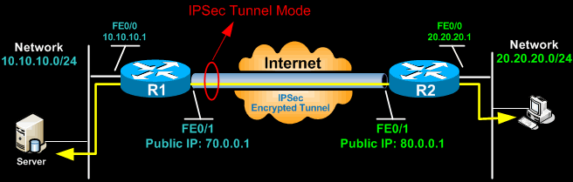
IPsec modes
IPsec can operate in two modes of operation
  (1) Layer 2 tunnel mode (default mode)
    Typically used to tunnel IP traffic between two security gateways
    IPsec protects the full IP datagram (including IP headers)
      New IP header is created
    Automatic NAT traversal
Notes:
IPsec can be implemented in a host-to-host transport mode, as well as in a network tunneling mode.
Tunnel mode
IPSec tunnel mode is the default mode. The tunnel mode protects any internal routing info by encrypting the IP header of the ENTIRE packet. This means IPSec wraps the original packet, encrypts it, adds a new IP header and sends it to the other side of the VPN tunnel (IPSec peer). As such, the entire IP packet is encrypted and/or authenticated. Since additional headers are added to the packet there is less space available for payload.
Tunnel mode is used to create virtual private networks for network-to-network communications (e.g. between routers to link sites), host-to-network communications (e.g. remote user access) and host-to-host communications (e.g. private chat). NAT traversal is supported with the tunnel mode. In the example, the client connects to the IPSec Gateway. Traffic from the client is encrypted, encapsulated inside a new IP packet and sent to the other end. Once decrypted by the firewall appliance, the client’s original IP packet is sent to the local network.

Slide 9
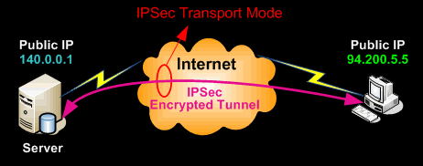
IPsec modes
IPsec can operate in two modes of operation
  (2) Transport mode
    Only the payload is encrypted / encapsulated
      IPsec transport mode offers limited protection to IP headers
    Mainly used to provide security services for upper layer protocols
Notes:
Transport mode
In transport mode, only the payload of the IP packet (and the ESP trailer) is usually encrypted and/or authenticated. The IP header of the original packet is neither modified nor encrypted, thus leaving the routing intact. The transport and application layers are always secured by hash, so they cannot be modified in any way (for example by translating the port numbers). Transport mode is implemented for client-to-site VPN scenarios.
IPSec Transport mode is most commonly used for end-to-end communications between devices with public IP addresses, for example for communication between a client and a server or between a workstation and a gateway (if the gateway is being treated as a host and is thus the actual destination). A good example would be an encrypted Telnet or Remote Desktop session from a workstation to a server. By default, NAT traversal IS NOT supported with the transport mode, but a means to encapsulate IPsec messages for NAT traversal has been defined by RFC documents describing the NAT-T mechanism.
IPSec transport mode is also used when another tunneling protocol (like GRE) is used to first encapsulate the IP data packet, then IPSec is used to protect the GRE tunnel packets. IPSec protects the GRE tunnel traffic in transport mode.

Slide 10
IPsec protocols: AH & ESP
IPSec consists of two main protocols:
  Authentication Header (AH)
  Encapsulating Security Payload (ESP)
Tunnel or transport mode can be implemented using the AH, ESP protocol or a combination of both
  Both modes can provide data-integrity, authentication and/or confidentiality, depending on the choice of the protocols

Slide 11
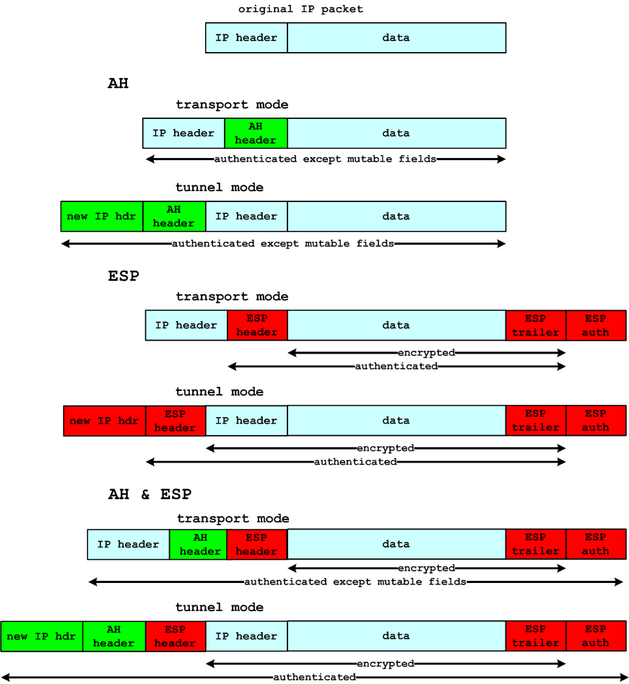
IPsec : authentication header (AH)
Authentication header
  Used for both transport and tunnel modes
Notes:
The Authentication Header (AH) [RFC2402] provides authentication and data integrity to the datagrams passed between two systems. This enables router/workstation to authenticate users or applications. The authentication prevents IP spoofing and implements an anti-replay mechanism.
Authentication and data integrity is achieved by applying a keyed one-way hash function to the datagram to create a MAC message digest (this requires a shared secret key). If any part of the datagram is changed during transit, this will be detected by the receiver when it performs the same one-way hash function on the datagram and compares the value of the message digest that the sender has supplied. The fact that the one-way hash also involves the use of a secret shared between the two systems means that authenticity can be guaranteed.
The AH function is applied to the entire datagram except for any mutable IP header fields that change in transit, such as Time To Live (TTL) fields that are modified by the routers along the transmission path. AH works as follows:
The IP header and data payload is hashed.
The hash is used to build a new AH header, which is appended to the original packet.
The new packet is transmitted to the IPSec peer router.
The peer router hashes the IP header and data payload, extracts the transmitted hash from the AH header, and compares the two hashes. The hashes must match exactly. If even one bit is changed in the transmitted packet, the hash output on the received packet will change and the AH header will not match.

Slide 12
IPsec: AH – transport and tunnel mode
server
transport mode
local network
public
network
transport mode
IPsec gateway
tunnel mode

Slide 13
IPsec : Encapsulating Security Payload (ESP)
ESP header
  Used for both transport and tunnel modes
Notes:
Encapsulating Security Payload (ESP) [RFC2406] is a security protocol used to provide confidentiality (encryption), data origin authentication, integrity, optional anti-replay service, and limited traffic-flow confidentiality by defeating traffic-flow analysis. The data payload is encrypted with ESP.
ESP (“Encapsulating Security Payload”) achieves 2 security features:
Confidentiality function. By encrypting the data and (optionally) IP header, confidentiality is guaranteed, and to some extent even traffic flow confidentiality is realized. For this purpose, traditional encryption algorithms are used, such as AES-128-CBC (MUST), AES-GCM , DES (obsolete)
(Optional) authentication. Using the same principles as for AH. Algorithms used include HMAC-SHA-1-96, AES-GMAC and “optional” support for other MACs.

Slide 14
IPsec: ESP – transport mode
ESP: transport mode
  From end point to end point:
    Encryption (and possibly authentication)
    No traffic flow confidentiality
    E.g. for teleworking
encrypted IP traffic
between end points
local
network
Internet

Slide 15
IPsec: ESP – tunnel mode
encrypted tunnels
with IP traffic
local
network
local
network
Internet
local
network
local
network
Notes:
The tunnel mode can prove useful if we want to create a VPN between different locations of a company. Not every single connected device requires IPSec capabilities. Only a security gateway, which connects the (reputedly safe) local network to the Internet, requires IPSec capabilities. In this case, the local traffic will not use IPSec, while outgoing traffic (to some other company location) will be encrypted by the security gateway. In this way, possibly confidential data will be transmitted securely over the Internet from one location to another. This configuration allows some traffic flow confidentiality, as an attacker outside one of the local networks can only observe between which local networks the traffic is flowing, but not between which workstations precisely. In practice, the security gateway will also contain a firewall to achieve other security services.

Slide 16
IPsec : ESP + AH
ESP + AH header
  Used for both transport and tunnel modes

Slide 17
IPsec transport mode
IPsec transport mode summary
  Different AH, ESP or AH+ESP combinations

Slide 18
IPsec tunnel mode
IPsec tunnel mode summary
  Different AH, ESP or AH+ESP combinations

Slide 19
IPsec: security associations
Security associations (SA)
  One-way relationship between sender and receiver
    Provides security services to traffic carried
    Two associations needed for bidirectional traffic
  Identified by
    SPI (“Security Parameters Index”)
    IP destination address (end user, firewall, router, etc.)
    Security protocol identification (AH or ESP)
    Obvious bundle: AH + ESP for single IP stream
Combining tunnels
  Not necessarily identical end points for each tunnel
  Several levels possible
  “Iterated tunneling”

Slide 20
IPsec: combining SAs – case 1
1 or more SAs
device with IPsec implementation
local
intranet
Internet
local
intranet
Notes:
Security between two end points. Possible combinations:
AH in transport mode
ESP in transport mode
AH, followed by ESP in transport mode (an ESP SA within an AH SA)
one of the previous within an AH or ESP in tunnel mode

Slide 21
IPsec: combining SAs – case 2
tunnel SA
intranet security gateway
device with IPsec implementation
local
intranet
Internet
local
intranet
Notes:
Traffic secured between gateways (routers, firewall, etc.). No IPsec implementation at end users. Basic support for VPN. IPsec specifies that a single tunnel (with AH, ESP, or ESP with authentication) is sufficient in this case. Nested tunnels aren’t required as the IPsec service applies to the entire original packet.

Slide 22
IPsec: combining SAs – case 3
tunnel SA
1 or 2 SAs
device with IPsec implementation
local
intranet
Internet
local
intranet
intranet security gateway
Notes:
Extension of case 2, offering security between the end points too. The tunnel offers authentication and/or confidentiality for traffic between intranets. Additional IPSec security may be added by the end users for the traffic within the local intranets.

Slide 23
IPsec: combining SAs – case 4
tunnel SA
1 or 2 SAs
device with IPsec implementation
Internet
local
intranet
intranet security gateway
Notes:
This is the scenario for an external user (e.g. teleworker) using the Internet to access the security gateway of the company (secured by the tunnel SA) and further on a server or workstation within the company (internal communication secured by the internal SAs).

Slide 24
Overview
Network model
Secure configuration of devices
Exchanging keys
Secure networking protocols
  Transport layer: TLS & SSL
  Network layer: IPSec & VPN
  Data link layer: WEB & WPA
Firewalls

Slide 25
VPNs
Basic principle of VPN
  VPN = secure tunnel from site to site
    Not just secure remote login
VPN box
site A
VPN box
site B
Internet
host
site A
host
site B
secure tunnel

Slide 26
VPNs
Options
  IPsec
  PPTP
    Point-to-Point Tunneling Protocol (Microsoft specific)
  L2TP
    Layer 2 Tunneling Protocol (Microsoft + CISCO)
  SSL/TLS
  SSH
  SSTP
    Secure Socket Tunneling Protocol
    Windows only
  ....

Slide 27
VPN: IPsec
Advantages
  Designed for this purpose
  Part of several other solutions
Disadvantages
  Complexity of IPsec
    Especially key exchange (using IKE)
  Interoperability issues between different (partial) implementations of the standard
  Issues with NAT and (non-IPsec) firewalls
    Mainly for AH

Slide 28
VPN: PPTP
Point-to-Point Tunneling Protocol
Advantages
  Client built-in to just about all platforms
  Very easy to set up
  Fast
Disadvantages
  Not at all secure (the vulnerable MS CHAPv2 authentication is still the most common in use)
  Definitely compromised by the NSA

Slide 29
VPN: openVPN
Build on the OpenSSL library using the SSL/TLS protocols
Advantages
  Highly configurable
  Very secure (probably even against the NSA)
  Can bypass firewalls
  Can use a wide range of encryption algorithms
  Open source (and can therefore be readily vetted for back doors and other NSA style tampering)
Disadvantages
  Needs third party software
  Can be fiddly to set up
  Support on mobile devices is improving, but is not as good as on the desktop
  Security on top of transport layer
    Instead of network layer security

Slide 30
VPN: L2TP and L2TP/IPsec
Layer 2 Tunnel Protocol (L2TP)
  On its own no encryption or confidentiality
  Therefore combines with IPsec
Advantages
  Usually considered very secure
  Easy to set up
  Available on all modern platforms
Disadvantages
  May be compromised by the NSA
  Likely deliberately weakened by the NSA
  Slower than OpenVPN
  Can struggle with restrictive firewalls

Slide 31
Test yourself
Give 5 examples of security problems that can be solved by IPsec but not by TLS or SSH
Which of the following security services can be achieved with IPsec: access control, integrity, authentication, confidentiality (which types)?
Which IPsec protocols provide traffic flow confidentiality? Why is this only a limited form of confidentiality?

